Slide 1




NEXT GEN EMPLOYABILITY PROGRAM
Creating a future-ready workforce
Team Members
College Name
Student Name : D.Shevitha
Student ID : 513521104046
5135-Annai Mira College Of Engineering and Technology

Slide 2

CAPSTONE PROJECT SHOWCASE
Project Title
Building Bus Reservation System using Python and Django
Abstract | Problem Statement | Project Overview | Proposed Solution | Technology Used | Modelling & Results | Conclusion

Slide 3
Abstract
ChatGPT
The Bus Reservation System project aims to automate and streamline the process of booking bus tickets for travelers, providing a convenient and efficient solution for both passengers and bus operators.
The system facilitates online ticket booking, seat selection, and payment processing, reducing the hassle of manual booking and long queues at ticket counters.
It incorporates features such as user registration, search and filtering options for routes and schedules, real-time seat availability updates, secure online payment integration, and generation of e-tickets for passengers.
Additionally, the system includes an administrative module for managing bus routes, schedules, fares, and user data, allowing operators to efficiently monitor and optimize their services.
By leveraging technology to enhance the booking experience, the Bus Reservation System project aims to improve customer satisfaction, increase operational efficiency, and promote the growth of the bus transportation industry.
Source :

Slide 4
Problem Statement The Bus Reservation System project aims to address these challenges by developing an automated and user-friendly platform for booking bus tickets. This system will streamline the booking process, provide real-time updates on seat availability, and facilitate secure online payments. Furthermore, it will offer tools for bus operators to manage routes, schedules, and fares efficiently, optimizing their operations and enhancing service quality. The key objectives of the Bus Reservation System project include: 1.Simplifying the booking process: Designing an intuitive user interface for passengers to search, select, and book bus tickets seamlessly. 2.Real-time updates: Implementing features to provide instant updates on seat availability, bus schedules, and booking status to passengers. 3.Secure payment integration: Integrating reliable payment gateways to facilitate secure online transactions, ensuring the safety of passenger data. 4.Administrative management: Developing a robust backend system for bus operators to manage routes, schedules, fares, and customer data effectively. 5.By addressing these challenges and meeting the objectives, the Bus Reservation System project aims to revolutionize the bus ticket booking experience, improve operational efficiency for bus operators, and enhance overall customer satisfaction in the transportation sector.
Source :

Slide 5
Project Overview
Passenger Module:
User Registration: Passengers can create accounts to access the booking system, providing necessary details such as name, contact information, and payment preferences.
Search and Booking: Passengers can search for bus routes based on origin, destination, date, and time preferences. They can view available seats, select preferred seats, and proceed with the booking process.
Seat Selection: Passengers can choose seats from an interactive seat map, with real-time updates on seat availability.
Secure Payment: The system integrates secure payment gateways to facilitate online transactions, ensuring the safety of passenger data.
E-Ticket Generation: Upon successful booking and payment, passengers receive electronic tickets via email or SMS, which they can present during boarding.
Admin Module:
Route Management: Bus operators can manage routes, including adding new routes, updating schedules, and setting fares.
Schedule Management: Operators can adjust bus schedules, allocate buses to routes, and monitor occupancy rates to optimize operations.
User Management: Admins can oversee passenger accounts, handle booking inquiries, and manage customer support efficiently.
Source :

Slide 6
Proposed Solution
Automated Booking Process:
Implement an intuitive online booking platform accessible via web and mobile applications, allowing passengers to search for routes, select seats, and make secure payments seamlessly.
Integrate real-time updates on seat availability, schedules, and booking status to provide passengers with accurate information and minimize booking errors.
Secure Payment Integration:
Integrate reliable payment gateways to facilitate secure online transactions, ensuring the safety of passenger data and enhancing trust in the booking process.
Administrative Management Tools:
Develop a robust admin module for bus operators to manage routes, schedules, fares, and customer data efficiently, enabling them to monitor and optimize operations effectively.
Provide reporting and analytics features to generate insights into booking trends, revenue generation, and passenger demographics, enabling data-driven decision-making.
E-Ticketing System:
Implement an electronic ticketing system to generate and deliver e-tickets to passengers via email or SMS, eliminating the need for physical tickets and reducing paper waste.
.
Source :

Slide 7
5.Customer Support:
Offer comprehensive customer support channels, including email, chat, and phone support, to assist passengers with booking inquiries, cancellations, or other issues promptly.
6.E-Ticketing System: Implement an electronic ticketing system to generate and deliver e-tickets to passengers via email or SMS, eliminating the need for physical tickets and reducing paper waste.
By implementing these solutions, the Bus Reservation System aims to revolutionize the bus ticket booking process, improving convenience, efficiency, and reliability for passengers while enabling bus operators to streamline operations and enhance service quality.
Source :

Slide 8
Objectives
1.Streamlined Booking Process: Develop an intuitive online platform for passengers to search, select, and book bus
tickets seamlessly, reducing the time and effort required for booking
2.Real-time Updates: Provide real-time updates on seat availability, bus schedules, and booking status to passengers, ensuring accurate and up-to-date information throughout the booking process.
3.Secure Payment Integration: Integrate secure payment gateways to facilitate safe and reliable online transactions, enhancing passenger trust and confidence in the booking system.
4.Efficient Administrative Management: Develop a robust administrative module for bus operators to manage routes, schedules, fares, and customer data efficiently, optimizing operational processes and resources.
5.Enhanced Customer Experience: Focus on improving the overall booking experience for passengers by offering user-friendly interfaces, responsive customer support, and convenient e-ticketing options.
6.Data-driven Decision-making: Implement reporting and analytics features to generate insights into booking trends, revenue generation, and passenger preferences, enabling bus operators to make informed decisions and optimize services. 7.Multi-platform Accessibility: Ensure accessibility of the reservation system across various devices and platforms, including web browsers and mobile applications, to cater to a wide range of users.
8.Scalability and Flexibility: Design the system architecture to be scalable and adaptable, allowing for future expansion, integration of additional features, and accommodation of growing passenger demands
Source :

Slide 9


Technology Used
Front-end
Back-end
Source :

Slide 10
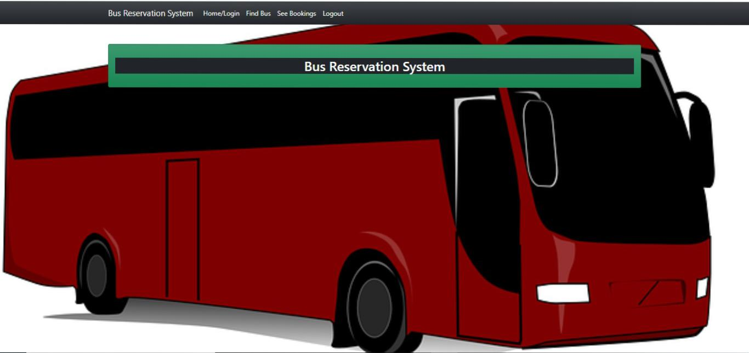
Modelling & Results
Source :

Slide 11
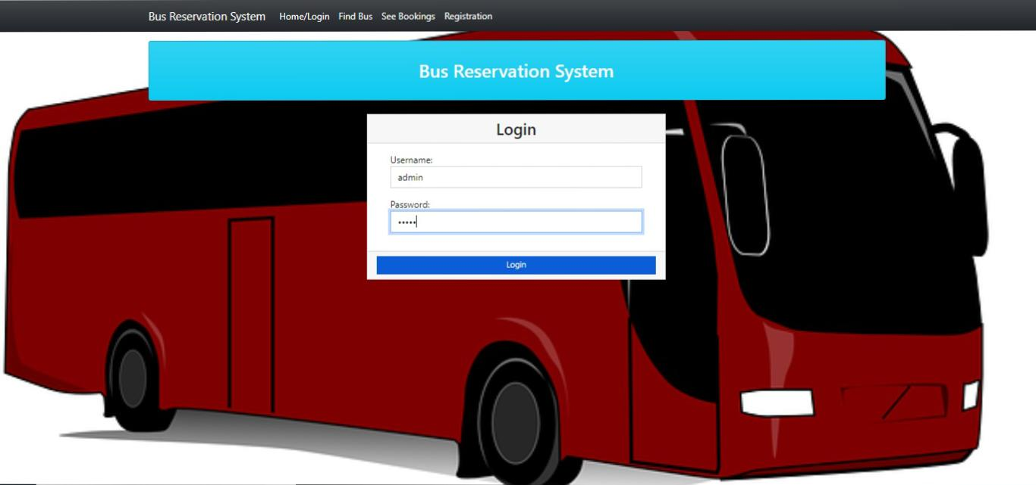
Login

Slide 12
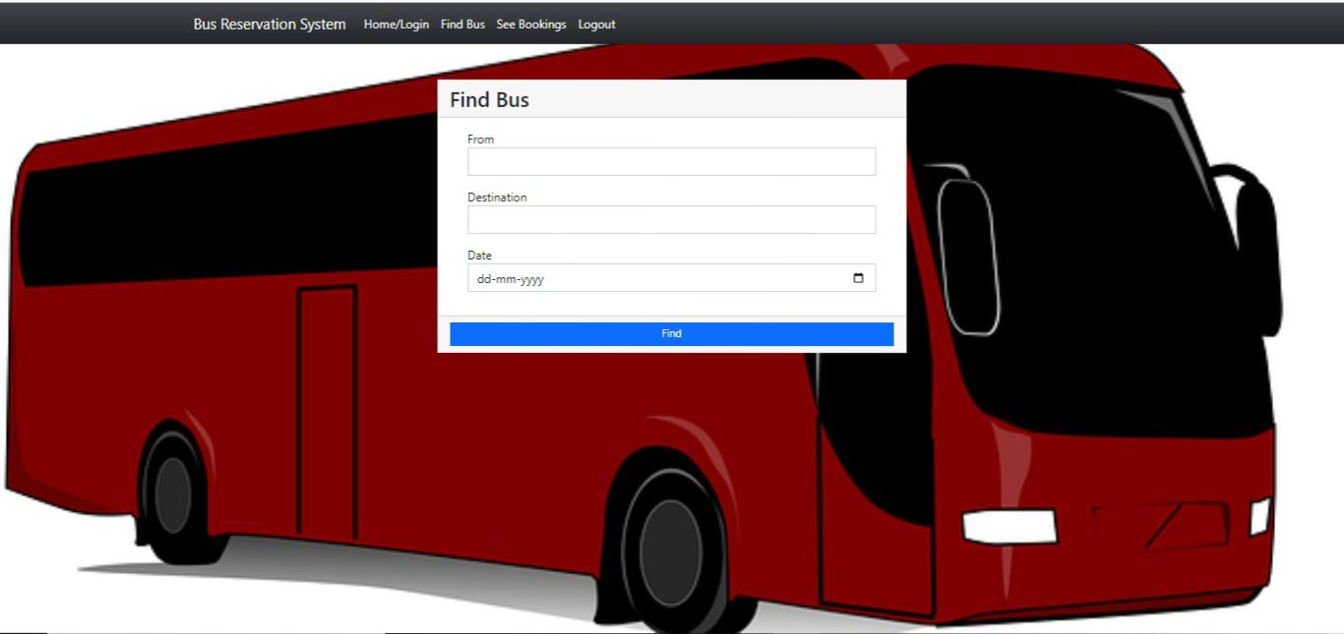
Find Bus

Slide 13
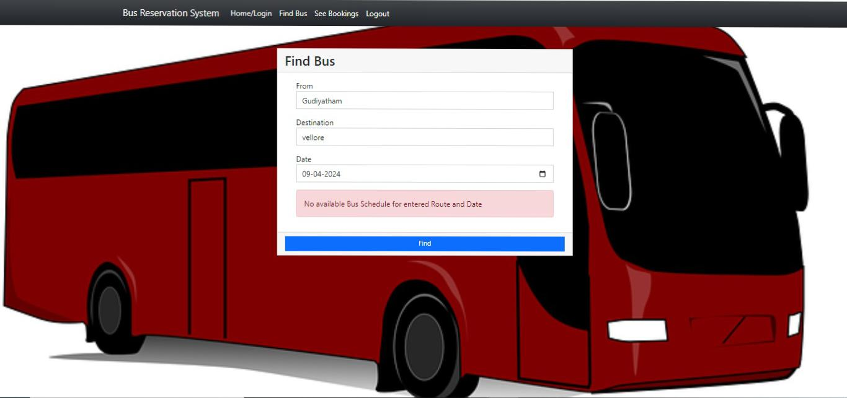

Slide 14
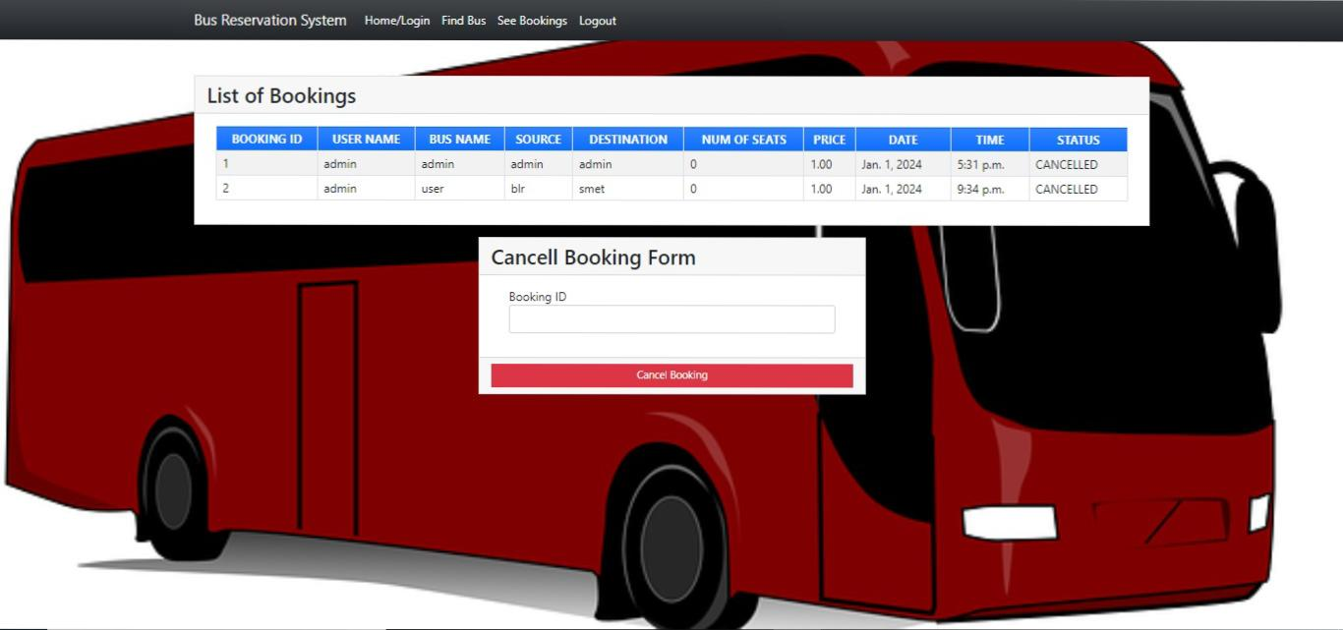
Bookings and canceling

Slide 15
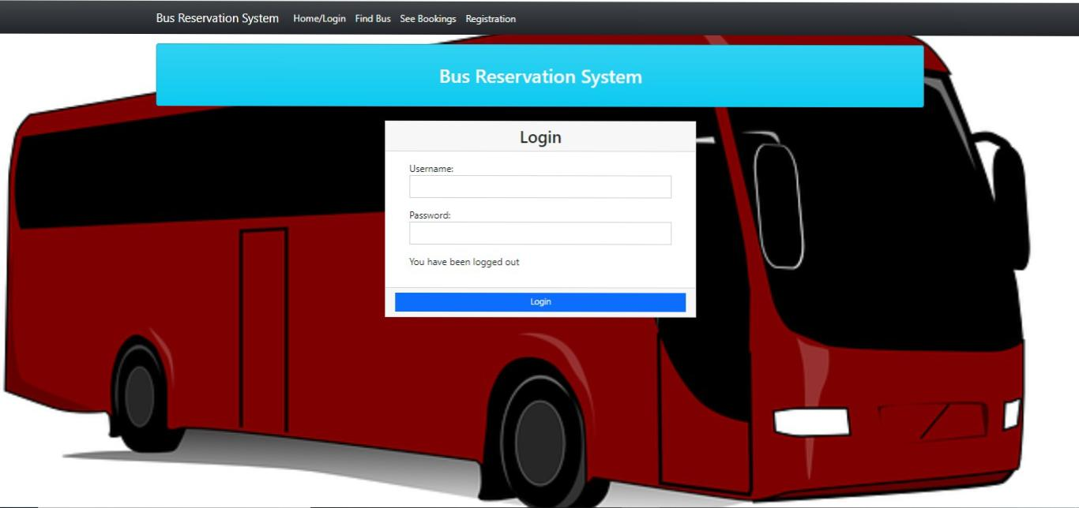
Logout

Slide 16
Future Enhancements:
Dynamic Pricing: Implement dynamic pricing algorithms that adjust ticket fares based on factors such as demand, time of booking, route popularity, and seat availability, optimizing revenue generation for bus operators while offering competitive pricing for passengers.
Predictive Analytics: Integrate advanced analytics tools to forecast booking patterns, identify trends, and anticipate demand fluctuations, enabling proactive decision-making in route planning, capacity management, and resource allocation.
Personalized Recommendations: Utilize machine learning algorithms to analyze passenger preferences, travel history, and behavior data to offer personalized route suggestions, seat recommendations, and promotional offers tailored to individual preferences, enhancing customer satisfaction and loyalty.
Multi-modal Integration: Expand the reservation system to integrate with other modes of transportation such as trains, flights, taxis, and ride-sharing services, providing passengers with seamless multi-modal journey planning and booking options.
Enhanced Accessibility Features: Develop accessibility features such as wheelchair-accessible seating options, real-time journey assistance for passengers with disabilities, and multilingual support to cater to diverse passenger needs and ensure inclusivity.
Smart Ticketing Solutions: Implement contactless ticketing solutions using Near Field Communication (NFC), QR codes, or mobile wallets to enable quick and hassle-free boarding, reducing waiting times and enhancing passenger convenience.
IoT-enabled Fleet Management: Equip buses with Internet of Things (IoT) devices and sensors to monitor vehicle health, driver behavior, passenger occupancy, and environmental conditions in real-time, enabling proactive maintenance, route optimization, and operational efficiency.

Slide 17
Conclusion
In conclusion, the Bus Reservation System represents a significant advancement in the transportation sector, offering a comprehensive solution to the challenges faced by both passengers and bus operators in the traditional manual booking process. By leveraging technology, automation, and user-centric design principles, the system aims to revolutionize the bus ticket booking experience, enhance operational efficiency, and improve overall customer satisfaction.
Through streamlined booking processes, real-time updates on seat availability, secure payment integration, and efficient administrative management tools, the Bus Reservation System simplifies the journey for passengers, reducing the time and effort required to book tickets while providing peace of mind and convenience. Additionally, the system empowers bus operators with data-driven insights, enabling them to optimize routes, schedules, and resources, ultimately leading to improved service quality and revenue generation.
Overall, the Bus Reservation System signifies a paradigm shift towards a more efficient, accessible, and customer-centric approach to bus ticket booking, laying the foundation for a seamless and enjoyable travel experience for passengers while driving innovation and sustainability in the transportation industry.
Source :

Slide 18
Thank You!
Notes:
Thank You !!

